Slide 1
CMSC424: Database Design Module: NoSQL; Big Data Systems
Overview; Parallel/Distributed Architectures
Instructor: Amol Deshpande
amol@umd.edu

Slide 2
NoSQL and Big Data Systems: Motivation
Book Chapters
10.1, 10.2 (7TH EDITION)
Key topics:
Big data motivating scenarios
Why systems so far (relational databases, data warehouses, parallel databases) don’t work

Slide 3
RDBMS: Application Scenarios
Online Transaction Processing (OLTP)
E-commerce, Airline Reservations, Class registrations, etc.
Simple queries (get all orders for a customer)
Many updates (inserts, updates, deletes)
Need ACID properties (consistency, etc.)
Online Analytical Processing (OLAP)
Decision-support, data mining, ML (today), etc.
Huge volumes of data, but not updated
Complex, but read-only queries (many joins, group-by’s)

Slide 4
RDBMS Evolution
Original database systems aimed to support both use cases
Slowly, specialized systems were built, starting late 80’s-early 90’s, especially for decision support (Data Warehouses)
Today, different RDBMSs systems for different use cases, e.g.,:
VoltDB for OLTP – fully in-memory, very fast transactions, but no complex queries
Teradata, Aster Data, Snowflake, AWS Redshift – handle PBs of data, but batch updates only – many indexes and summary structures (cubes) for queries – typically “parallel” (i.e., use many machines)
Fundamental and wide differences in the technology
But both still support SQL as the primary interface (with visualizations, exploration, and other tools on top)

Slide 5
NoSQL + Big Data Systems: Motivation
Very large volumes of data being collected
Driven by growth of web, social media, and more recently internet-of-things
Web logs were an early source of data
Analytics on web logs has great value for advertisements, web site structuring, what posts to show to a user, etc
Big Data: differentiated from data handled by earlier generation databases
Volume: much larger amounts of data stored
Velocity: much higher rates of insertions
Variety: many types of data, beyond relational data

Slide 6
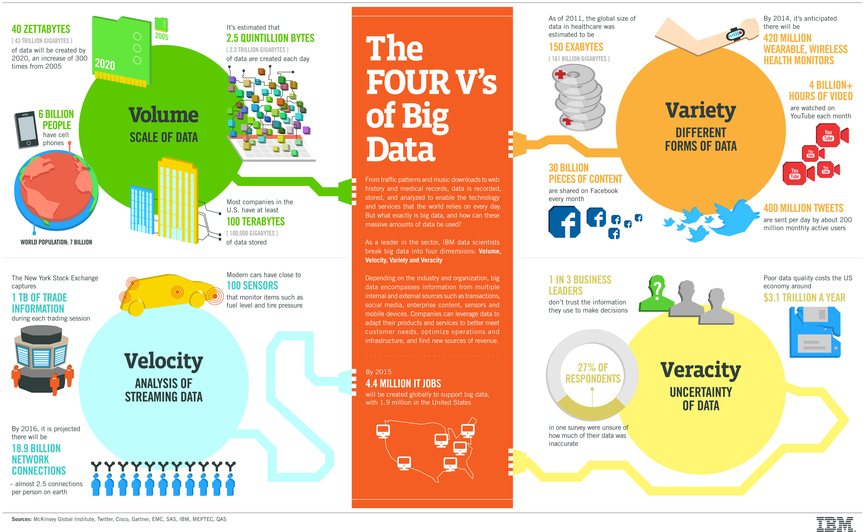

Slide 7
Some motivating scenarios
Deciding what to show a user in a social network, or news aggregator
Advertising on the Web or Mobile
Analyzing user behavior on web sites to optimize or increase engagement
Analyzing large numbers of images and building search indexes on them
Text analytics for topic modelling, summarization, …
Internet of things…
And many many others…

Slide 8
Two Primary Use Cases
OLTP-like
Simple queries, but lots of updates
Need to support distributed users
Need to support non-relational data (e.g., graphs, JSONs)
Need to scale fast (10 users to 10s of Millions of Users)
Need to work well in 3-tier Web Apps
Need to support fast schema changes
OLAP-like
Complex analysis on large volumes of data
Often no “real-time” component, and no updates
Mostly non-relational data (images, webpages, text, etc)
Tasks often procedural in nature (analyse webpages for searching, data cleaning, ML)

Slide 9
Why (Parallel) Databases Don’t Work
The data is often not relational in nature
E.g., images, text, graphs
The analysis/queries are not relational in nature
E.g., Image Analysis, Text Analytics, Natural Language Processing, Web Analytics, Social Network Analysis, Machine Learning, etc.
Databases don’t really have constructs to support this
User-defined functions can help to some extent
Need to interleave relational-like operations with non-relational (e.g., data cleaning, etc.)
Domain users are more used to procedural languages
The operations are often one-time
Only need to analyse images once in a while to create a “deep learning” model
Databases are really better suited for repeated analysis of the data
Much of the analysis not time-sensitive
Parallel databases too expensive given the data volumes
Were designed for large enterprises, with typically big budgets

Slide 10
Parallel and Distributed Architectures
Ability to scale “up” a computer is limited ➔ Use many computers together
Called cluster or network of computers (and today, just a “data center”)
Also need to ”meet” where the users are
To minimize interactive latencies (e.g., social networks)
Has made parallel and distributed architectures very common today

Slide 11
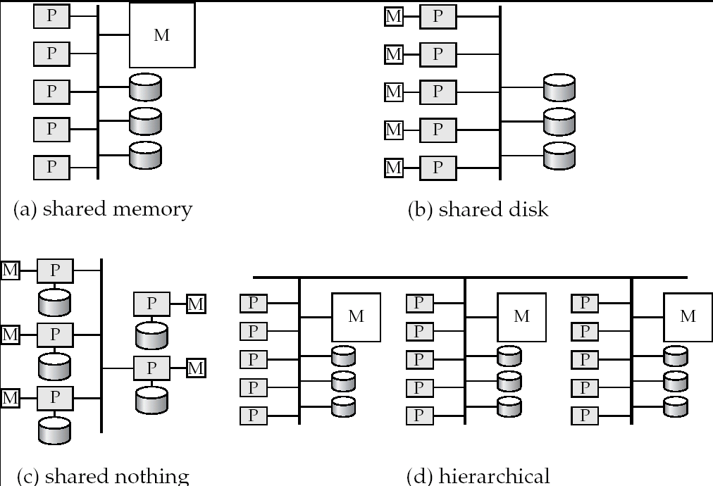
Parallel Architectures
Shared-nothing vs. shared-memory vs. shared-disk

Slide 12
Parallel Architectures

Slide 13
Parallel Architectures
Shared Memory
Shared Disk
Shared Nothing
Communication between processors
Extremely fast
Disk interconnect is very fast
Over a LAN, so slowest
Scalability ?
Not beyond 32 or 64 or so (memory bus is the bottleneck)
Not very scalable (disk interconnect is the bottleneck)
Very very scalable
Notes
Cache-coherency an issue
Transactions complicated; natural fault-tolerance.
Distributed transactions are complicated (deadlock detection etc);
Main use
Low degrees of parallelism
Not used very often
Everywhere

Slide 14
Parallel Systems
A coarse-grain parallel machine → a small number of powerful processors
A massively parallel or fine grain parallel machine → thousands of smaller processors.
We see a variety of mixes of these today, especially with the rise of multi-core machines
Two main performance measures:
throughput --- the number of tasks that can be completed in a given time interval
response time --- the amount of time it takes to complete a single task from the time it is submitted

Slide 15
Speed-Up and Scale-Up
Speedup: a fixed-sized problem executing on a small system is given to a system which is N-times larger.
Measured by:
speedup = small system elapsed time
large system elapsed time
Speedup is linear if equation equals N.
Scaleup: increase the size of both the problem and the system
N-times larger system used to perform N-times larger job
Measured by:
scaleup = small system small problem elapsed time
big system big problem elapsed time
Scale up is linear if equation equals 1.

Slide 16
Factors Limiting Speedup and Scaleup
Sequential computation: Some parts may not be parallalelizable
Amdahl’s Law: If “p” is the fraction of the task that can be parallelized, then the best speedup you can get is:
If ”p” is 0.9, the best speedup is 10
Startup costs: Cost of starting up multiple processes may dominate computation time, if the degree of parallelism is high.
Interference: Processes accessing shared resources (e.g., system bus, disks, or locks) compete with each other, thus spending time waiting on other processes, rather than performing useful work.
Skew: Increasing the degree of parallelism increases the variance in service times of parallely executing tasks. Overall execution time determined by slowest of parallely executing tasks.

Slide 17
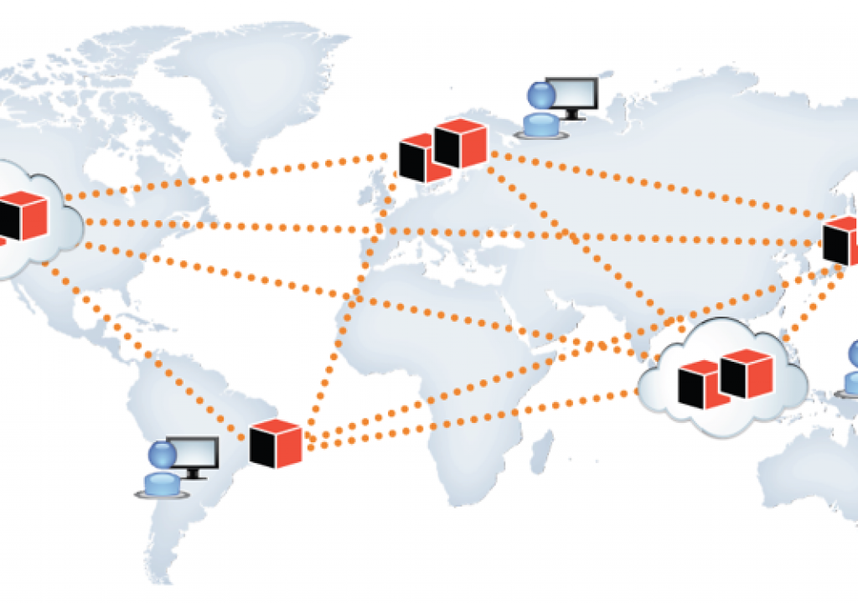
What about “Distributed” Systems?
Over a wide area network
Typically not done for performance reasons
For that, use a parallel system
Done because of necessity
Imagine a large corporation with offices all over the world
Or users distributed across the globe
Also, for redundancy and for disaster recovery reasons

Slide 18
CMSC424: Database Design Module: NoSQL; Big Data Systems
Data Replication; Sharding; Failures
Instructor: Amol Deshpande
amol@umd.edu

Slide 19
Parallel or Distributed Systems
Key Questions from Data Management Perspective:
How to partition (or “shard”) data across a collection of storage devices/machines
How to execute an “operation” across a group of computers
In different configurations (shared-memory vs shared-disk vs shared-nothing vs NUMA)
Trade-offs and bottlenecks can be vastly different
How to execute an “update” across a group of computers
Need to ensure consistency
How to deal with “failures”

Slide 20
Data Partitioning
Partition a relation or a dataset across machines
Typically through “hashing”
Advantages:
In-memory computation: data fits in memory across machines
Parallelism: simple read/write queries can be distributed across machines
Disadvantages:
Complex queries: require combining data across all partitions, especially “joins” are tricky
R1, S1
Machine 1
Machine 1 can directly read R1, S1
If it wants R2, Machine 2 must read it and send it to Machine 1
Partitions of R (Not different relations)
R2, S2
Machine 2
R3, S3
Machine 3

Slide 21
Data Replication
A data item (file, relation, relation fragment, object, tuple) is replicated if it is stored redundantly in two or more sites
Advantages:
Availability: failures can be handled through replicas
Parallelism: queries can be run on any replica
Reduced data transfer: queries can go to the “closest” replica
Disadvantages:
Increased cost of updates: both computation as well as latency
Increased complexity of concurrency control: need to update all copies of a data item/tuple
R
Machine 1
Read queries can go to any machine
Write queries must go to “all” machines (if we want consistency)
e.g., what if Application 1 writes to Machine 1, and Application 2 sends its write to Machine 3
-- May result in an inconsistent state
R
Machine 2
R
Machine 3

Slide 22
Data Sharding + Replication
Many data management systems today combine both
Partition a dataset/file/relation into smaller pieces and distributed it across machines
Replicate each of the pieces multiple times
This may be done:
In a data center with very fast networks, or
In a wide-area setting with slower networks and higher latencies
So need to worry about:
Efficient execution of complex queries
Consistency for updates
Recovery from failures

Slide 23
Failures
Need to consider:
Disk failures: one of the disks (hard drives or SSDs) fails
Not uncommon with 10’s of thousands of disks
Network failures: machines may not be able to talk to each other
Machine failure: a machine crashes during the execution of a query or a transaction
Required guarantees:
Shouldn’t lose any data if a disk fails
Consistency (when making updates) shouldn’t be affected if one of the involved machines fails
Or if machines are not able to talk to each other
Shouldn’t have to restart a complex analytics task entirely if one of the involved machines fails

Slide 24
CMSC424: Database Design Module: NoSQL; Big Data Systems
Overview (Cntd)
Instructor: Amol Deshpande
amol@umd.edu

Slide 25
Two Primary Use Cases
OLTP-like
Simple queries, but lots of updates
Need to support distributed users
Need to support non-relational data (e.g., graphs, JSONs)
Need to scale fast (10 users to 10s of Millions of Users)
Need to work well in 3-tier Web Apps
Need to support fast schema changes
OLAP-like
Complex analysis on large volumes of data
Often no “real-time” component, and no updates
Mostly non-relational data (images, webpages, text, etc)
Tasks often procedural in nature (analyse webpages for searching, data cleaning, ML)
NoSQL Storage Systems: HDFS, Cassandra, MongoDB, Neo4j, AWS DynamoDB, and many many others
Big data frameworks:
Hadoop MapReduce, Flink, Spark, and many others

Slide 26
Examples of Systems
Too much variety in the systems out there today
different types of data models supported
Files/Objects (HDFS, AWS S3), Document (MongoDB), Graph (Neo4j), Wide-table (Cassandra, DynamoDB), Multi-Model (Azure CosmosDB)
different types of query languages or frameworks or workloads
SQL (Snowflake, Redshift, …), MongoQL, Cassandra QL, DataFrames (Spark), MapReduce (Hadoop), TensorFlow for ML, …
different environmental assumptions
Distributed vs parallel, disks or in-memory only, single-machine or not, streaming or static, etc.
different performance focus and/or guarantees
e.g., consistency guarantees in a distributed setting differ quite a bit
Many of these systems work with each
e.g., Spark can read data from most of the storage systems
Interoperability increasing a requirement

Slide 27
What We Will Cover
The original MapReduce framework
Led to development of much work on large-scale data analysis (OLAP-style)
Basically a way to execute a group-by at scale on non-relational data
Apache Spark
Current leader in big data (OLAP-style) frameworks
Supports many query/analysis models, including a light version of SQL
How to “Parallelize” Operations
Useful to understand how Spark and other systems actually work
Often times you have to build these in the application layer
Hadoop Distributed File System (briefly)
A key infrastructure piece, with no real alternative
Basic file system interface, with replication and redundancy built in for failures
MongoDB
Perhaps the most popular NoSQL system, uses a ”document” (JSON) data model
Focus primarily on OLTP
Doesn’t really support joins (some limited ability today) – have to do that in the app
Quick overview of other NoSQL data models

Slide 28
CMSC424: Database Design Module: NoSQL; Big Data Systems
MapReduce Overview
Instructor: Amol Deshpande
amol@umd.edu

Slide 29
Big Data; Storage Systems
Book Chapters
10.3 (7TH EDITION)
Key topics:
Why MapReduce and History
Word Count using MapReduce

Slide 30
The MapReduce Paradigm
Platform for reliable, scalable parallel computing
Abstracts issues of distributed and parallel environment from programmer
Programmer provides core logic (via map() and reduce() functions)
System takes care of parallelization of computation, coordination, etc.
Paradigm dates back many decades
But very large scale implementations running on clusters with 10^3 to 10^4 machines are more recent
Google Map Reduce, Hadoop, ..
Data storage/access typically done using distributed file systems or key-value stores

Slide 31
MapReduce Framework
Provides a fairly restricted, but still powerful abstraction for programming
Programmers write a pipeline of functions, called map or reduce
map programs
inputs: a list of “records” (record defined arbitrarily – could be images, genomes etc…)
output: for each record, produce a set of “(key, value)” pairs
reduce programs
input: a list of “(key, {values})” grouped together from the mapper
output: whatever
Both can do arbitrary computations on the input data as long as the basic structure is followed

Slide 32
MapReduce Framework
input files
mappers
intermediate
files
reducers
output
files

Slide 33
Word Count Example

Slide 34
MapReduce Framework: Word Count
input files
mappers
(a, 1)
(b, 1)
(a, 1)
(c, 1)
(d, 1)
(b, 1)
intermediate
files
reducers
output
files
a b a c d b
(a, 1)
(a, 1)
(c, 1)
(a, 1)
(a, 1)
(a, 1)
…
(a, 8)
(c, 5)
b c d a a a
(b, 1)
(d, 1)
(b, 1)
(b, 1)
(d, 1)
(b, 1)
…
(b, 6)
(d, 2)
a b a b a b
c c c c c

Slide 35
More Efficient Word Count
input files
mappers
(a, 2)
(b, 2)
(c, 1)
(d, 1)
intermediate
files
reducers
output
files
a b a c d b
(a, 2)
(a, 3)
(c, 1)
(c, 5)
(a, 8)
(c, 5)
b c d a a a
…
(b, 6)
(d, 2)
a b a b a b
c c c c c
Called “mapper-side” combiner

Slide 36
Hadoop MapReduce
Google pioneered original map-reduce implementation
For building web indexes, text analysis, PageRank, etc.
Hadoop -- widely used open source implementation in Java
Huge ecosystem built around Hadoop now, including HDFS, consistency mechanisms, connectors to different systems (e.g., key-value stores, databases), etc.
Apache Spark a newer implementation of Map-Reduce
More user-friendly syntax
Significantly faster because of in-memory processing
SQL-like in many ways (“DataFrames”)

Slide 37
Summary
Traditional databases don’t provide the right abstractions for many newer data processing/analytics tasks
Led to development of NoSQL systems and Map-Reduce (or similar) frameworks
Easier to get started
Easier to handle ad hoc and arbitrary tasks
Not as efficient
Over the last 10 years, seen increasing convergence
NoSQL stores increasingly support SQL constructs like joins and aggregations
Map-reduce frameworks also evolved to support joins and SQL more explicitly
Databases evolved to support more data types, richer functionality for ad hoc processing
Think of Map-Reduce systems as another option
Appropriate in some cases, not a good fit in other cases

Slide 38
CMSC424: Database Design Module: NoSQL; Big Data Systems
Apache Spark
Instructor: Amol Deshpande
amol@umd.edu

Slide 39
Apache Spark
Book Chapters
10.4 (7TH EDITION) covers this topic, but Spark programming guide is a better resource
Assignments will refer to the programming guide
Key topics:
A Resilient Distributed Dataset (RDD)
Operations on RDDs

Slide 40
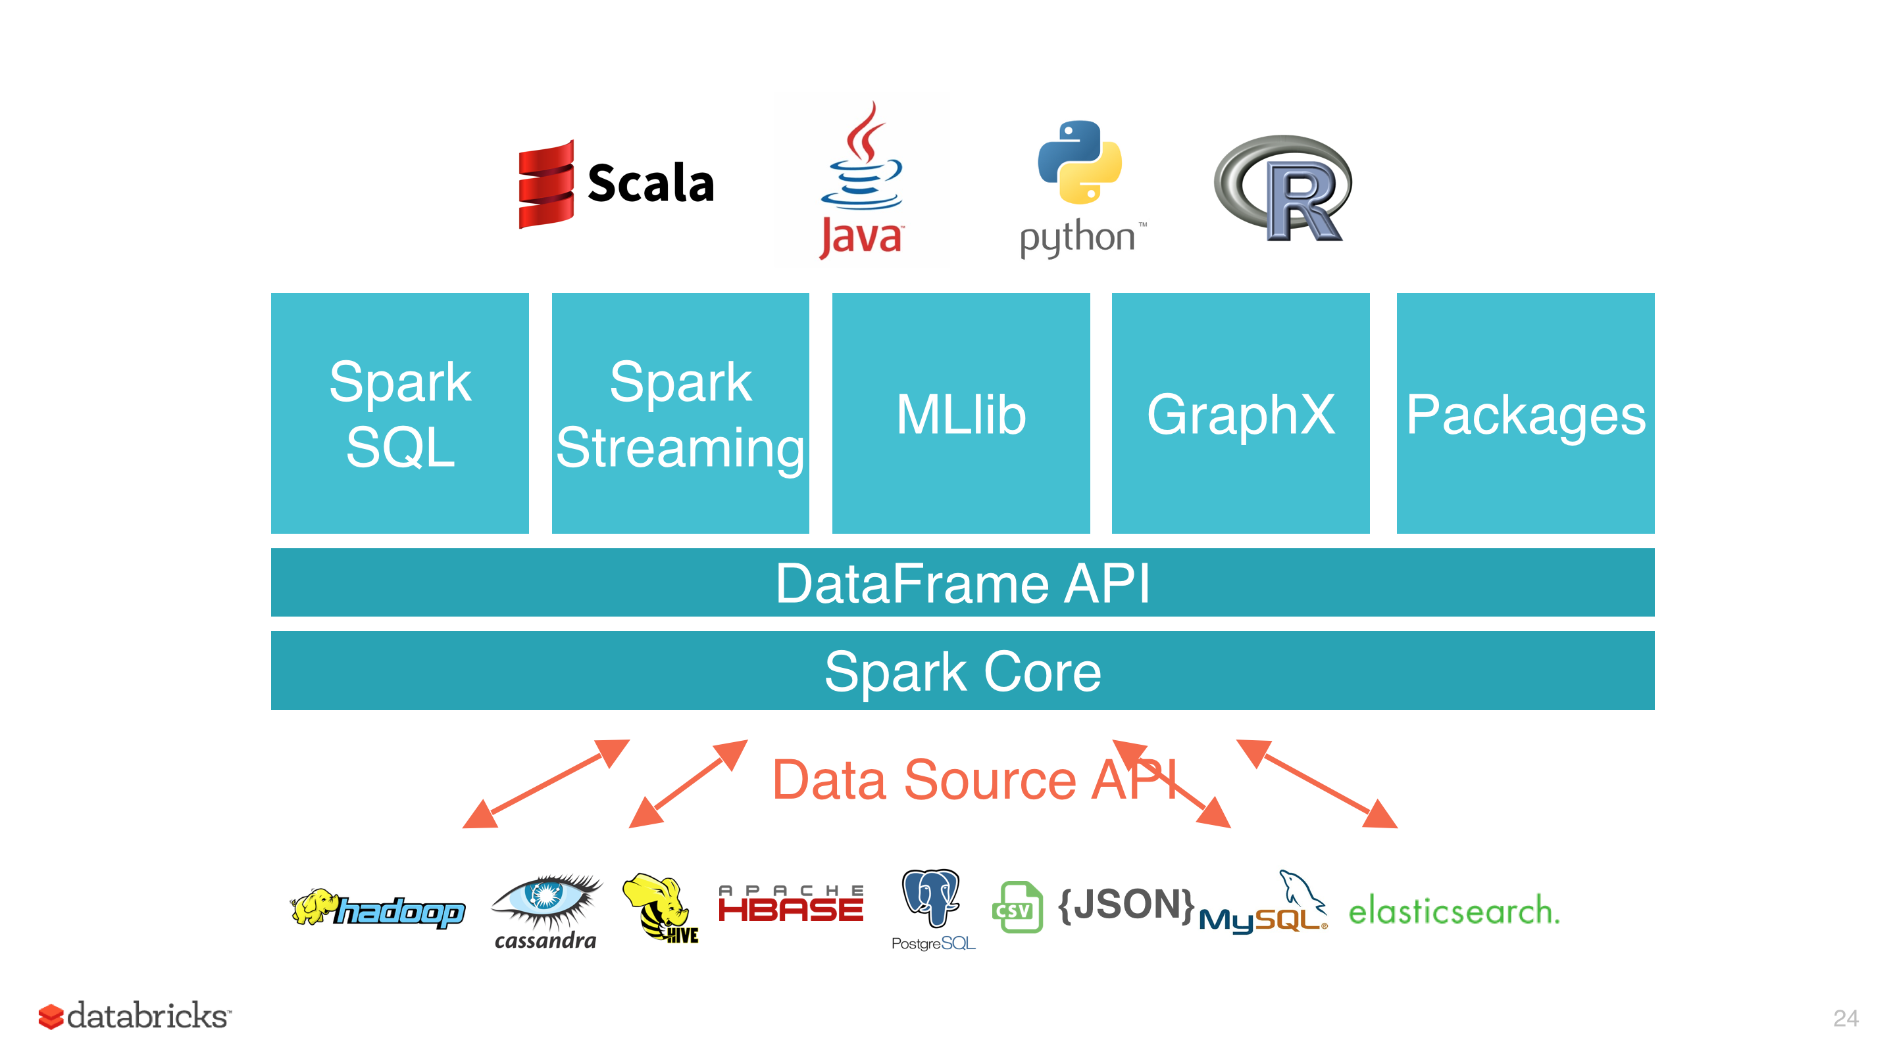
Spark
Open-source, distributed cluster computing framework
Much better performance than Hadoop MapReduce through in-memory caching and pipelining
Originally provided a low-level RDD-centric API, but today, most of the use is through the “Dataframes” (i.e., relations) API
Dataframes support relational operations like Joins, Aggregates, etc.

Slide 41
Resilient Distributed Dataset (RDD)
RDD = Collection of records stored across multiple machines in-memory
Drivers
Come and go
Not fault-tolerant
In-memory partitions of RDD 1
RDD Manipulation Commands
Worker Nodes
- Always running
Results – typically at the end
In-memory partitions of RDD 2
In-memory partitions of RDD 3

Slide 42
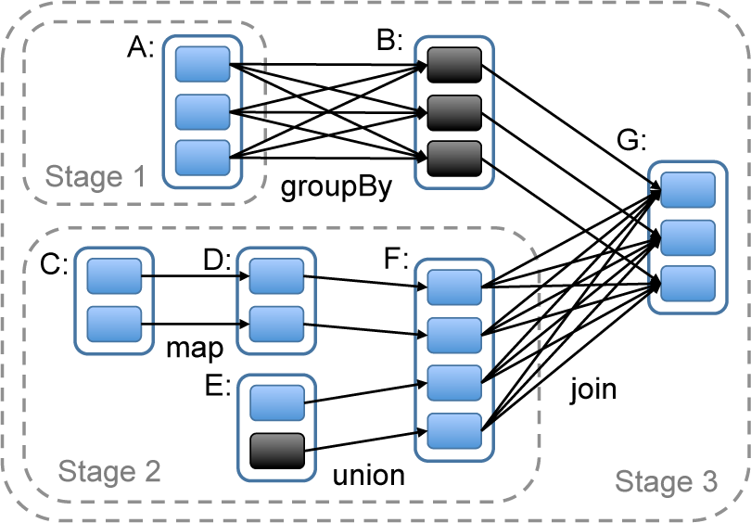
Spark
Why “Resilient”?
Can survive the failure of a worker node
Spark maintains a “lineage graph” of how each RDD partition was created
If a worker node fails, the partitions are recreated from its inputs
Only a small set of well-defined operations are permitted on the RDDs
But the operations usually take in arbitrary ”map” and “reduce” functions
Fault tolerance for the “driver” is trickier
Drivers have arbitrary logic (cf., the programs you are writing)
In some cases (e.g., Spark Streaming), you can do fault tolerance
But in general, driver failure requires a restart

Slide 43
Example Spark Program
Driver
Initialize RDD by reading the textFile and partitioning
If textFile stored on HDFS, it is already partitioned – just read each partition as a separate RDD partition
from pyspark import SparkContext
sc = SparkContext("local", "Simple App")
textFile = sc.textFile("README.md")
counts = textFile
.flatMap(lambda line: line.split(" "))
.map(lambda word: (word, 1))
.reduceByKey(lambda a, b: a + b)
print(counts.take(100))
Split each line into words, creating an RDD of words
For each word, output (word, 1), creating a new RDD
Do a group-by SUM aggregate to count the number of times each word appears
Retrieve 100 of the values in the final RDD

Slide 44
Spark
Operations often take in a ”function” as input
Using the inline “lambda” functionality
Or a more explicit function declaration
Similarly ”reduce” functions essentially tell Spark how to do pairwise aggregation
Spark will apply this to the dataset pair of values at a time
Difficult to do something like “median”
flatMap(lambda line: line.split(" "))
def split(line):
return line.split(" ")
flatMap(split)
reduceByKey(lambda a, b: a + b)

Slide 45
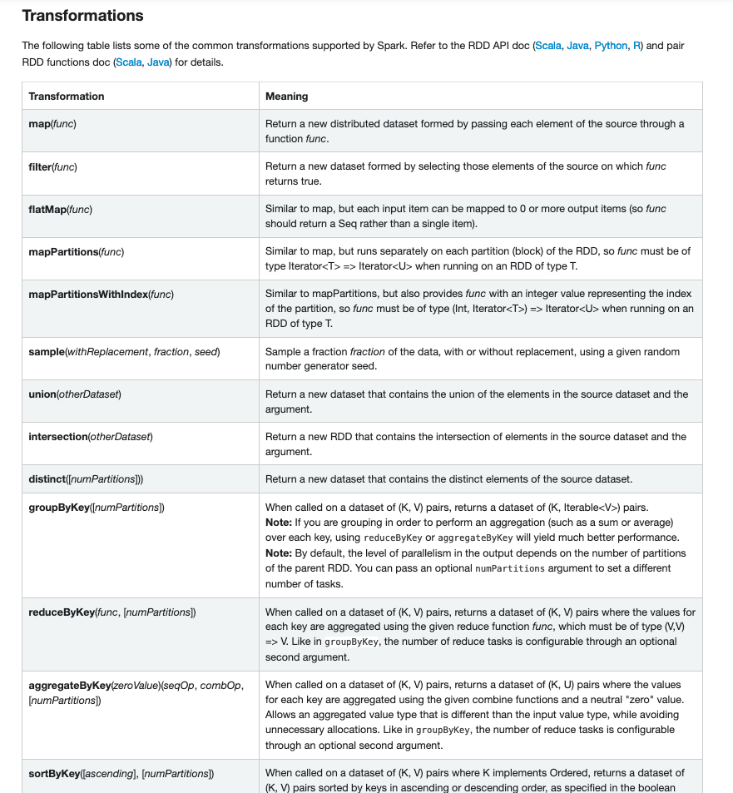
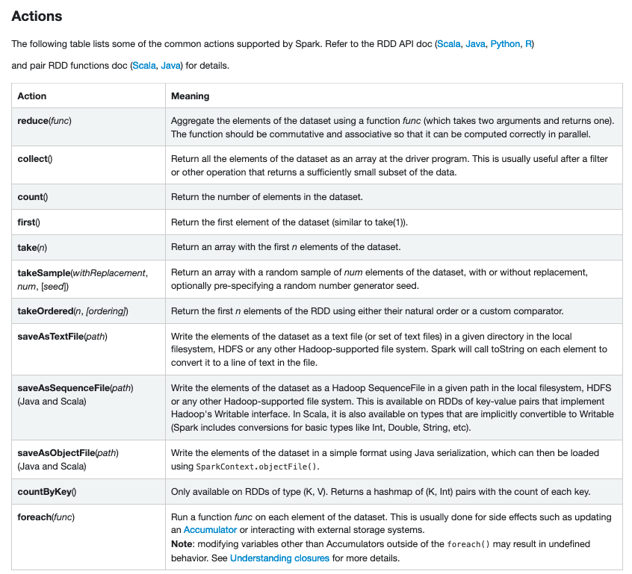
RDD Operations

Slide 46
Dataframes Example
def basic_df_example(spark):
# $example on:create_df$
# spark is an existing SparkSession
df = spark.read.json("examples/src/main/resources/people.json")
# Displays the content of the DataFrame to stdout
df.show()
# +----+-------+
# | age| name|
# +----+-------+
# |null|Michael|
# | 30| Andy|
# | 19| Justin|
# +----+-------+
# $example off:create_df$
# $example on:untyped_ops$
# spark, df are from the previous example
# Print the schema in a tree format
df.printSchema()
# root
# |-- age: long (nullable = true)
# |-- name: string (nullable = true)
# Select only the "name" column
df.select("name").show()
# +-------+
# | name|
# +-------+
# |Michael|
# | Andy|
# | Justin|
# +-------+
# Select everybody, but increment the age by 1
df.select(df['name'], df['age'] + 1).show()
# +-------+---------+
# | name|(age + 1)|
# +-------+---------+
# |Michael| null|
# | Andy| 31|
# | Justin| 20|
# +-------+---------+
# Select people older than 21
df.filter(df['age'] > 21).show()
# +---+----+
# |age|name|
# +---+----+
# | 30|Andy|
# +---+----+
# Count people by age
df.groupBy("age").count().show()
# +----+-----+
# | age|count|
# +----+-----+
# | 19| 1|
# |null| 1|
# | 30| 1|
# +----+-----+
# $example off:untyped_ops$
sqlDF = spark.sql("SELECT * FROM people")
sqlDF.show()
# +----+-------+
# | age| name|
# +----+-------+
# |null|Michael|
# | 30| Andy|
# | 19| Justin|
# +----+-------+
# $example off:run_sql$
# $example on:global_temp_view$
# Register the DataFrame as a global temporary view
df.createGlobalTempView("people")
# Global temporary view is tied to a system preserved database `global_temp`
spark.sql("SELECT * FROM global_temp.people").show()
# +----+-------+
# | age| name|
# +----+-------+
# |null|Michael|
# | 30| Andy|
# | 19| Justin|
# +----+-------+

Slide 47
Summary
Spark is a popular and widely used framework for large-scale computing
Managed services supported by several vendors including Databricks (started by the authors of Spark), Cloudera, etc.
Many other concepts that we did not discuss
Shared accumulator and broadcast variables
Support for Machine Learning, Graph Analytics, Streaming, and other use cases
Alternatives include: Apache Tez, Flink, and several others

Slide 48
CMSC424: Database Design Module: NoSQL; Big Data Systems
Parallelizing Operations
Instructor: Amol Deshpande
amol@umd.edu

Slide 49
Parallelizing Operations
Book Chapters
18.5, 18.6
Key topics:
Parallelizing a Sort Operation
Parallelizing a Join Operation
Parallelizing a Group By Operation

Slide 50
Setup
Assume Shared-Nothing Model
Relations are already partitioned across a set of machines (will talk about how next video)
How to execute different operations?
R1, S1
Processor 1
Processor 1 can directly read R1, S1
If it wants R2, Processor 2 must read it and send it to Processor 1
Partitions of R (Not different relations)
R2, S2
Processor 2
R3, S3
Processor w

Slide 51
Parallel Sort
Each processor sorts a portion of the data (e.g., the data on their local disk)
If the data is small enough, all the processors can send it to a single machine to do a “merge”
If the data is large, then ”merge” itself done in parallel through range partitioning
Each processor in the merge phase gets assigned a range of the data
All other processors send the appropriate data based on that range partitioning
In either phase, the processors work by themselves (“data parallelism”) but data must be “shuffled” in between
Other approaches exist, but basically same steps

Slide 52
Parallel Sort
Partitions of R (Not different relations)
Can be same machines or different
R1
Sort R1 Locally
tuples with R.a < 100
Sort received tuples
100 <= R.a < 200
R2
Sort R2 Locally
Sort received tuples
200 <= R.a < 500
Sort R3 Locally
500 <= R.a
Sort received tuples
R3
Sort R4 Locally
Sort received tuples
R4
Shuffle – typically expensive

Slide 53
Parallel Join
Hash-based approach
Very similar to how partitioning hash join works (i.e., the variant we saw for the case when the relations don’t fit in memory)
Most common for equi-joins where hashing can be used
Easier to guarantee balanced work
Sort-based approach
Similar to the parallel sort approach
Both relations sorted using the same key
Same processor used for merging in the second phase for both relations

Slide 54
Hash-based Parallel Join
R1, S1
Read R1 and Partition
Read S1 and Partition
R1 and S1 tuples with h(a) = 1
Join the R and S
tuples with h(a) = 1
h(a) = 2
R2, S2
Read R2 and Partition
Read S2 and Partition
Join the R and S
tuples with h(a) = 2
h(a) = 3
Read R3 and Partition
Read S3 and Partition
h(a) = 4
Join the R and S
tuples with h(a) = 3
R3, S3
Read R4 and Partition
Read S4 and Partition
Join the R and S
tuples with h(a) = 4
R4, S4
Shuffle – typically expensive

Slide 55
Fragment-and-Replicate Join
Partitioning not possible for some join conditions
E.g., non-equijoin conditions, such as r.A > s.B.
For joins were partitioning is not applicable, parallelization can be accomplished by fragment and replicate technique
Special case – asymmetric fragment-and-replicate:
One of the relations, say r, is partitioned; any partitioning technique can be used.
The other relation, s, is replicated across all the processors.
Processor P_{i} then locally computes the join of r_{i} with all of s using any join technique.

Slide 56
Asymmetric Fragment and Replicate
R1, S1
Read S1 and send
it around
All S1 tuples (no need to send if same machine)
Join R1 with all of S
All S1 tuples
R2, S2
Read S2 and send
it around
Join R2 with all of S
All S1 tuples
Read S3 and send
it around
All S1 tuples
Join R3 with all of S
R3, S3
Read S4 and send
it around
Join R4 with all of S
R4, S4

Slide 57
Grouping/Aggregation
Very common operation, especially in Map-Reduce applications
E.g., grouping by “hostnames” or “words” (as in project 5) or “labels” (in ML context), etc.
The idea of distributing data, doing some computations, and collecting results is quite powerful
Even ”joins” can be seen as a “group by” operation (you can group the tuples of the two relations on the join attribute, and then compute join)
Need to differentiate between “groupby” and “aggregate” (”reduce”)
Groupby: For every value of ”group by attribute” (i.e., “key”), collect all tuples/records with that key on a single machine
Aggregate/Reduce: Perform some computation on them, typically reducing the size of the data
Spark has more granular operations than SQL
Challenges:
Number of keys might be very large
Should try to do as much pre-aggregation as possible

Slide 58
Scenario 1: Small # of Groups + Reduce
Partitions of R (Not different relations)
(a, 5, ..)
(b, 3, ..)
(a, 4, ..)
(a, 9, ..)
(b, 3, ..)
R1
Group tuples of R1;
Compute
partial aggregates
Combine partial
aggregates
Partial aggregates
R2
Group tuples of R2;
Compute
partial aggregates
R3
Group tuples of R3;
Compute
partial aggregates
Similarly to how we have seen, ”average” would require sending ”sum” an “count”, etc
Amount of data transferred low
Requires a proper aggregate/reduce, and small number of groups
R4
Group tuples of R4;
Compute
partial aggregates

Slide 59
Scenario 2: Large # of Groups + Reduce
Use hashing to redistribute data
(a, 5, ..)
(b, 3, ..)
(a, 4, ..)
R1
Group tuples of R1;
Compute
partial aggregates
(a, 9, ..)
Combine partial
aggregates
(b, 3, ..)
R2
Group tuples of R2;
Compute
partial aggregates
Combine partial
aggregates
R3
Group tuples of R3;
Compute
partial aggregates
Combine partial
aggregates
R4
Group tuples of R4;
Compute
partial aggregates
Combine partial
aggregates

Slide 60
Scenario 3: Large # of Groups + No Reduce
e.g., if we want to compute “median” or some other complex statistics – no “partial aggregation” possible
R1
Group tuples of R1;
Redistribute using
Hashing
Compute aggregates
Or reduce functions
R2
Group tuples of R2;
Redistribute using
Hashing
Compute aggregates
Or reduce functions
R3
Group tuples of R3;
Redistribute using
Hashing
Compute aggregates
Or reduce functions
R4
Group tuples of R4;
Redistribute using
Hashing
Compute aggregates
Or reduce functions

Slide 61
Other Relational Operations
Selection σ_{θ}(r)
If θ is of the form a_{i} = v, where a_{i} is an attribute and v a value.
If r is partitioned on a_{i} the selection is performed at a single processor.
If θ is of the form l <= a_{i} <= u (i.e., θ is a range selection) and the relation has been range-partitioned on a_{i}
Selection is performed at each processor whose partition overlaps with the specified range of values.
In all other cases: the selection is performed in parallel at all the processors.

Slide 62
Other Relational Operations (Cont.)
Duplicate elimination
Perform by using either of the parallel sort techniques
eliminate duplicates as soon as they are found during sorting.
Can also partition the tuples (using either range- or hash- partitioning) and perform duplicate elimination locally at each processor.
Projection
Projection without duplicate elimination can be performed as tuples are read in from disk in parallel.
If duplicate elimination is required, any of the above duplicate elimination techniques can be used.

